Slide 1

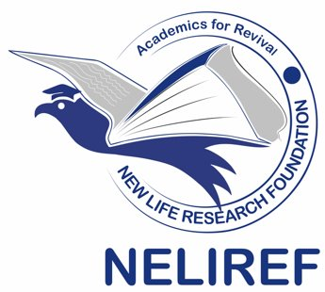
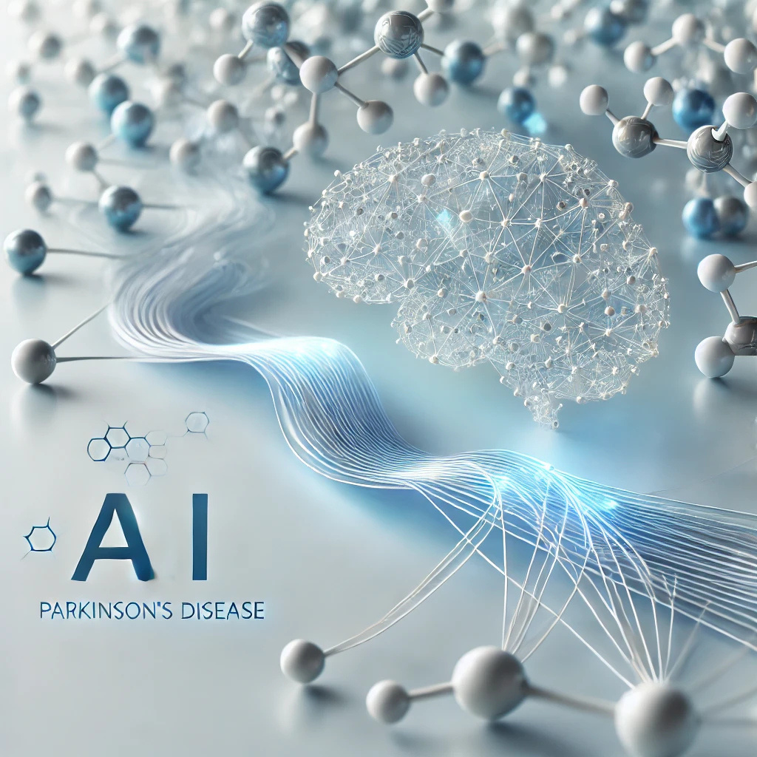




2nd Data Science & AI Summer School 2025
Introduction to NLP, LLMs, Generative AI & Foundation Models
Instructor: Joseph Luper Tsenum
Teaching Assistants (TAs): Alexander Takele Mengesha, Amos Aondover Kwaghfan
June 28, 2025
+1 (678) 975-5615
www.neliref.org
contact@neliref.org
New Life Research Foundation (NELIREF) Ltd/Gte
Notes:
Good afternoon everyone!
Thank you for being here today.
We are Bio-PrecisionAI we’re passionate about changing the game in drug discovery using AI. Right now, we’re focused on developing small drug molecules for Parkinson’s disease, a condition that impacts over 10 million people worldwide and still doesn’t have a cure.
Our AI platform is designed to accelerate drug discovery, improve treatment outcomes, and address the urgent needs of patients. Now, we’d like to take you through how we’re turning this vision into reality.

Slide 2
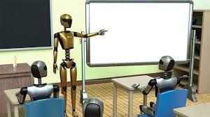
What is Artificial Intelligence?
"AI is a machine’s ability to perform the cognitive functions we associate with human minds, such as perceiving, reasoning, learning, interacting with an environment, problem solving, and even exercising creativity." ~ McKinsey.
You interact with AI daily without realizing it such as Siri voice assistants, customer service chatbots, Generative AI such as ChatGPT, gaming, predictive models for risk/protective factors in healthcare, forecasting models in businesses, mobile banking, fraud detection, customer engagement, social media such as Facebook, etc.
Driverless cars, scheduling of elevators, self-navigating vaccum cleaners are some of the applications of Reinforcement learning.

Slide 3
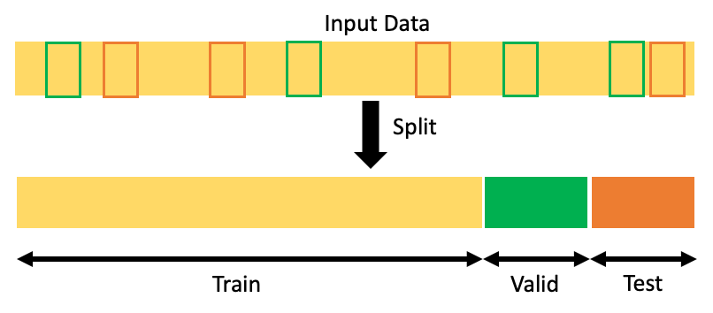
What is Machine Learning?
Machine Learning is the science of teaching machines how to learn by themselves. It is a type of artificial intelligence based on algorithms that are trained on data.
In 1970s, machine learning was applied in medical-imaging analysis and high-resolution weather forecasting.
Today, ML can learn from data and detect patterns thereby making predictions to help in decision and policy making.
Deep learning is a type of machine learning that can process large amounts of data such as images, bulk biological data, etc.
DL requires less human intervention, and can produce more accurate results (unsupervised learning) than traditional or classical machine learning methods (supervised learning). New patterns are learned.
Source: https://towardsdatascience.com/how-to-split-data-into-three-sets-train-validation-and-test-and-why-e50d22d3e54c

Slide 4
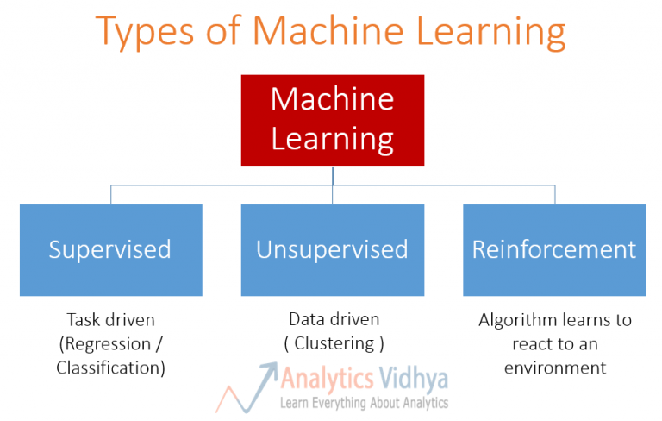

Slide 5
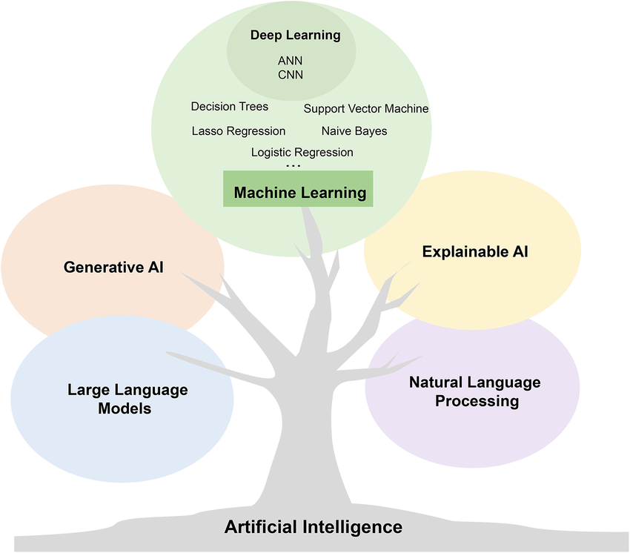
AI Revolution

Slide 6
What is Natural Language Processing
Natural Language Processing (NLP) is a field of Artificial Intelligence that enables computers to understand, interpret, and generate human language.
Automates text understanding at scale
Core intersection of Linguistics, Computer Science, and AI and bridges communication between humans and machines
Used in in chatbots, machine translation, sentiment analysis, information retrieval
Empowers technologies like Google Search, Siri/Alexa, Grammarly, ChatGPT

Slide 7
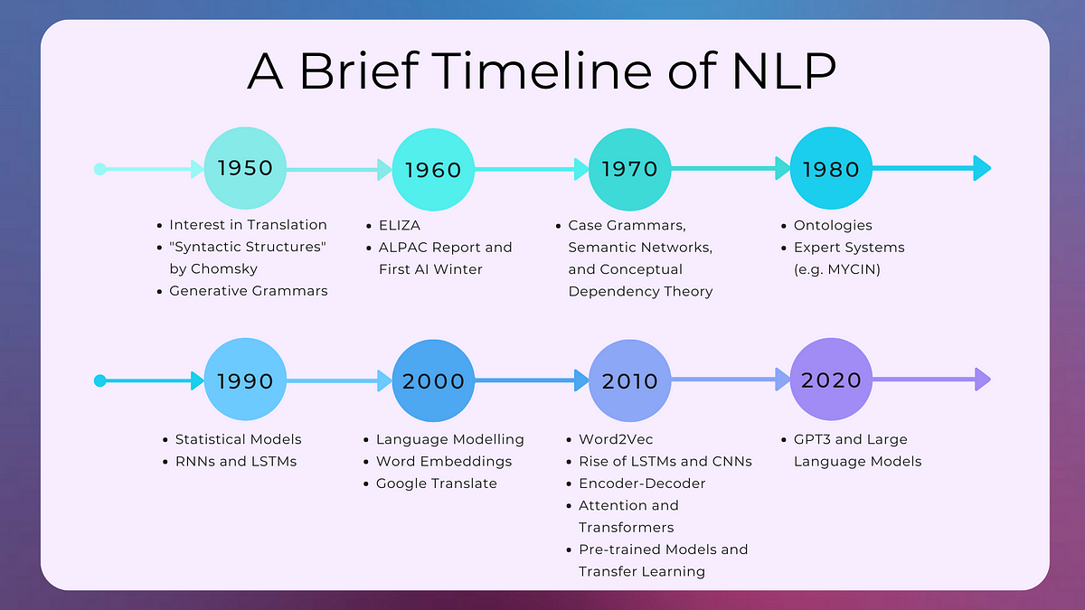
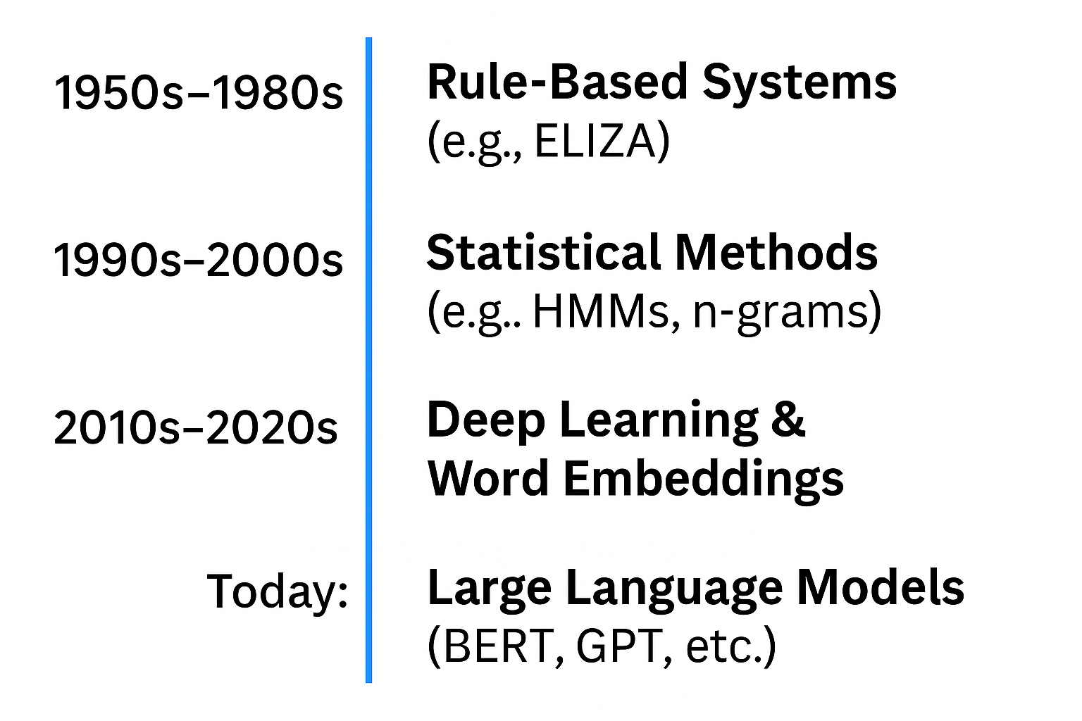

Slide 8
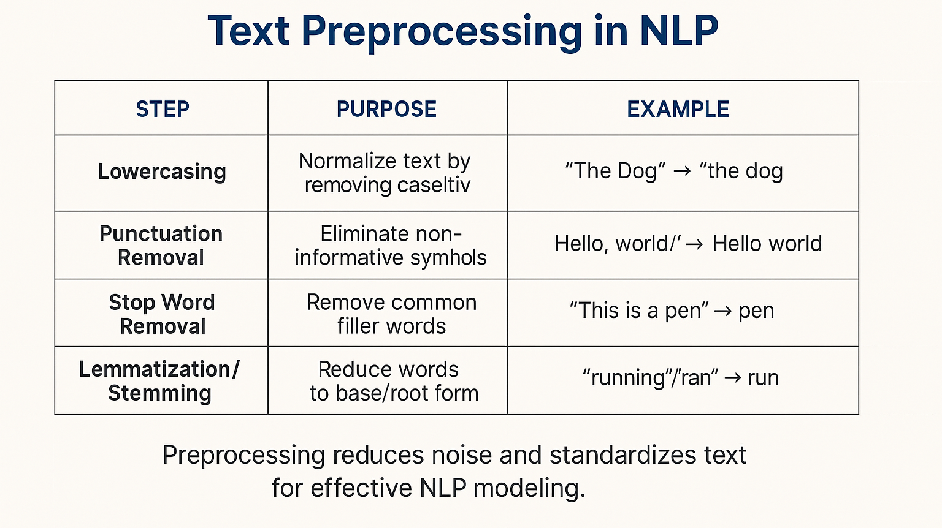

Slide 9
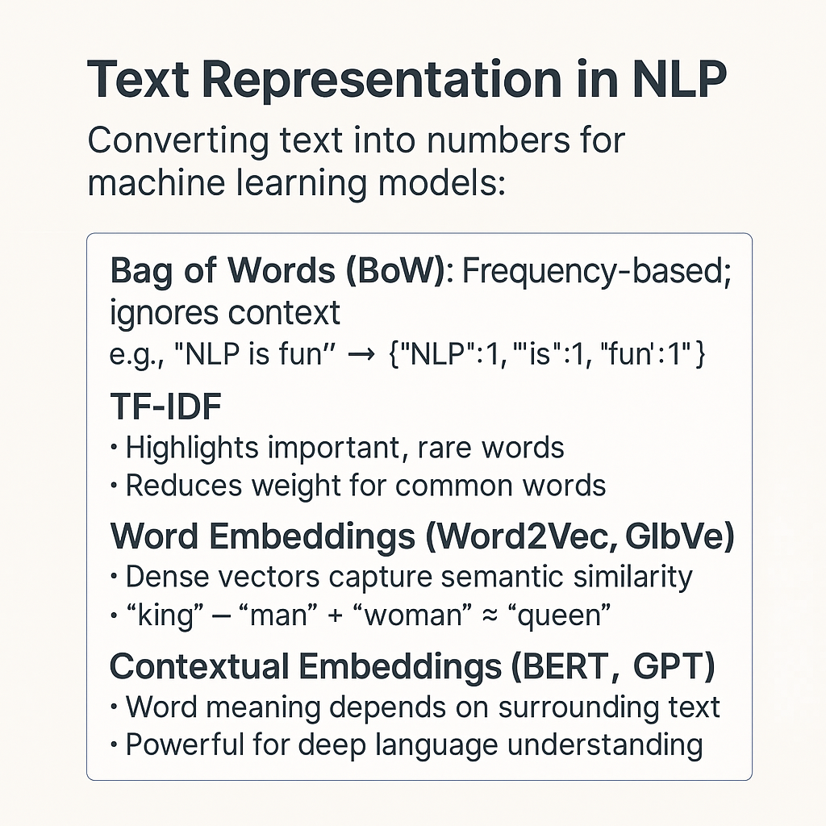
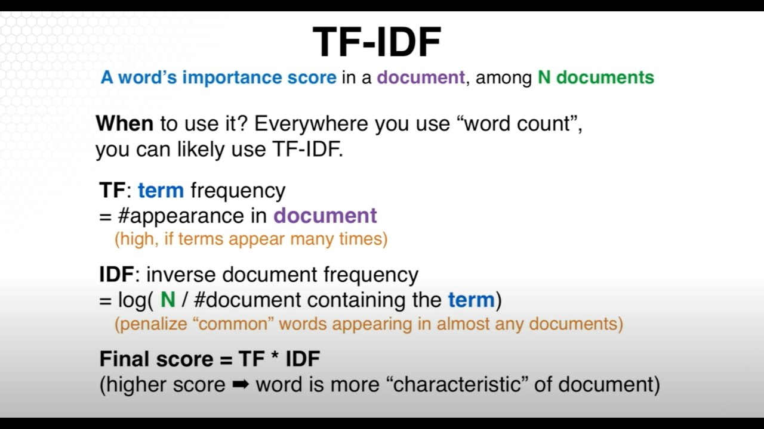

Slide 10
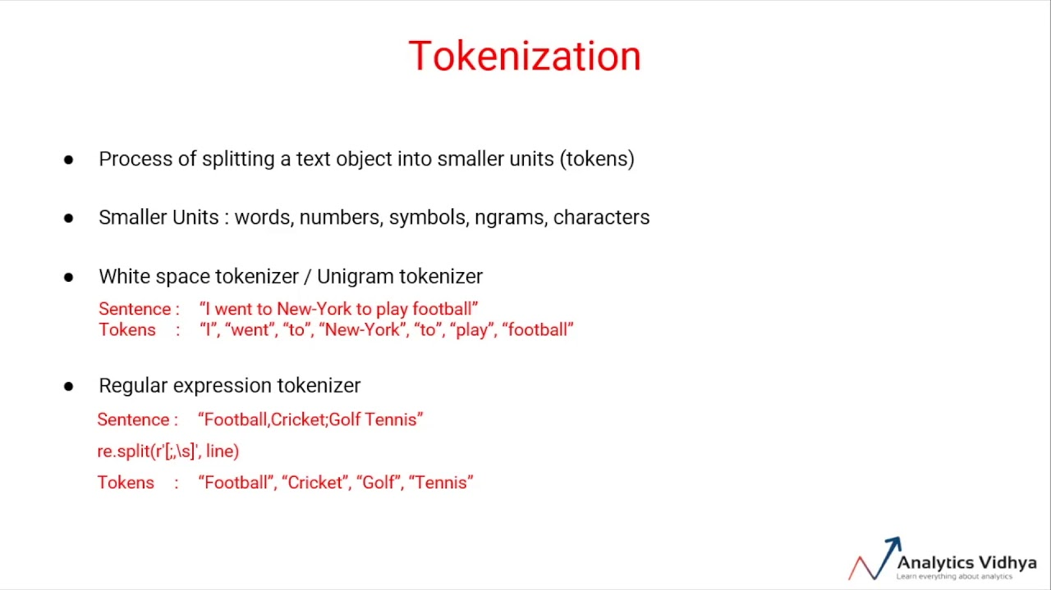
Tokenization
In Natural Language Processing (NLP), a token is an individual unit of text, such as a word, punctuation mark, or subword segment used for model processing.
The primary purpose of embeddings in Natural Language Processing (NLP) is to convert text into numerical vectors that capture semantic meaning

Slide 11
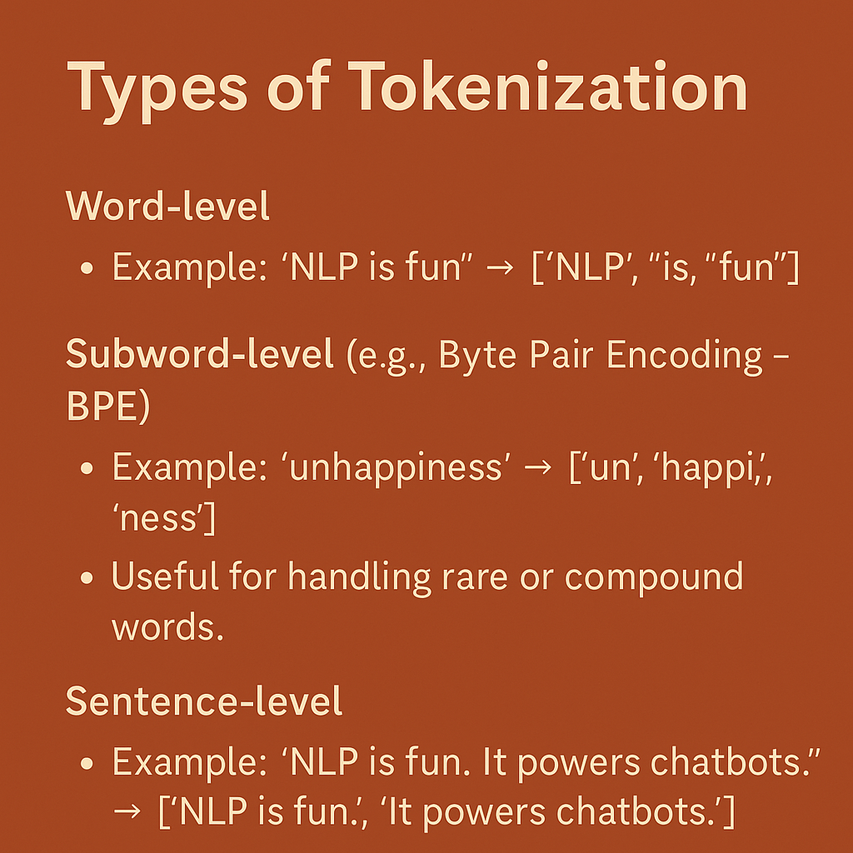
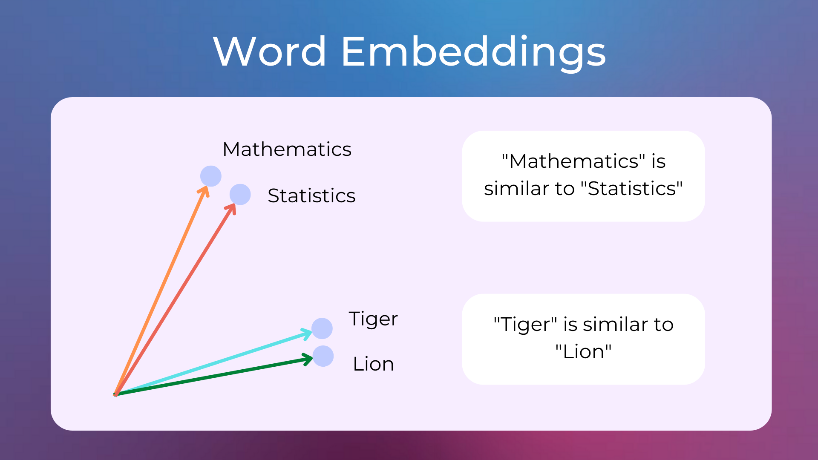

Slide 12
Popular NLP Tasks
Text Classification Sort text into categories e.g., spam vs not spam, sentiment analysis (positive vs negative)
Named Entity Recognition (NER) Identify and classify entities like names, dates, locations in text Example: “Apple was founded by Steve Jobs in 1976.” → ORG: Apple, PERSON: Steve Jobs, DATE: 1976
Machine Translation Automatically translate text from one language to another. Example: English ↔ French, using models like Google Translate or mBART
Summarization Generate concise versions of longer texts.
Extractive: Selects important sentences
Abstractive: Generates novel, condensed versions
e.g., news article → headline
Question Answering Extract or generate answers from a given context. Example: SQuAD-style: "Who founded Apple?" → “Steve Jobs”

Slide 13
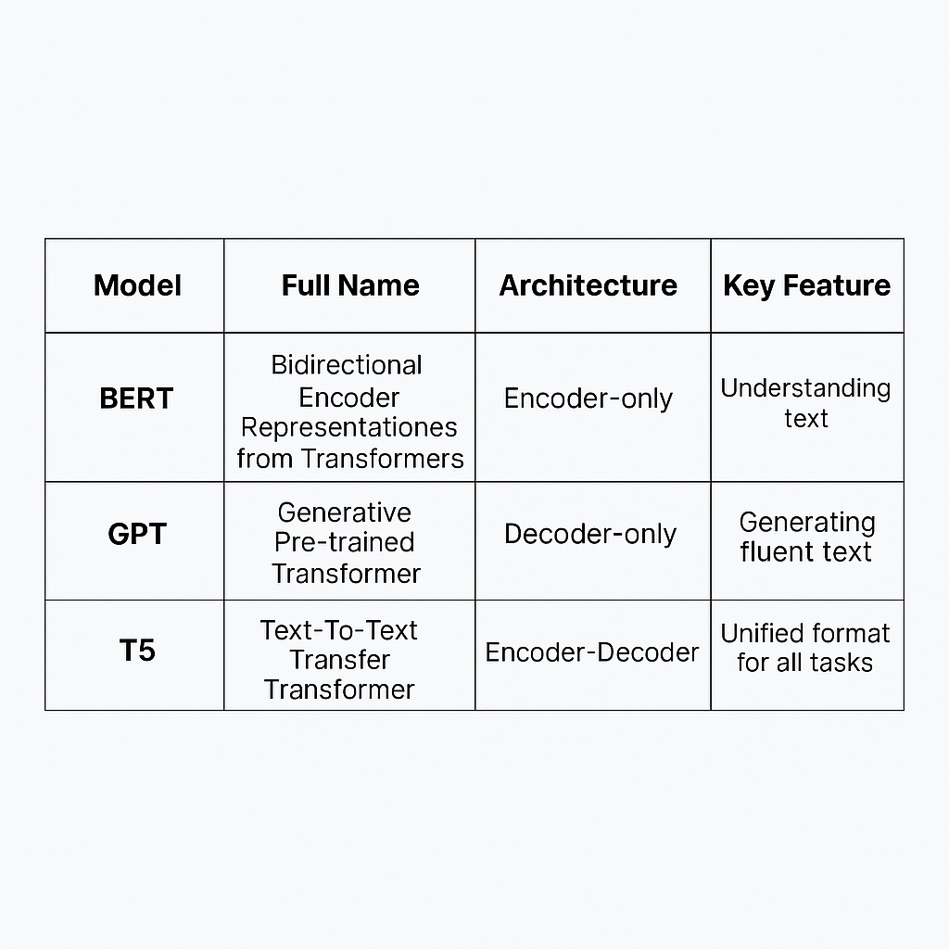
Language Models
N-gram Models: Predict next word based on N-1 previous
Neural Language Models: Use RNNs, LSTMs
Transformer Models: Parallelized, self-attention-based
Examples: BERT (Encoder), GPT (Decoder), T5 (Encoder-Decoder)
NB: BERT - Bidirectional Encoder Representations from Transformers
Generative Pre-trained Transformer
Text-To-Text Transfer Transformer

Slide 14

Generative AI & Attention Mechanism
In Generative AI models like Transformers, Autoencoders and Diffusion Models, the encoder processes input data into a context-rich representation, while the decoder uses this representation to generate the output.
Generative AI methods include Generative Adversarial Networks (GANs), Variational Autoencoders (VAEs), Diffusion Models, Transformer-based Language Models (e.g., GPT), Autoregressive Models, etc.

Slide 15
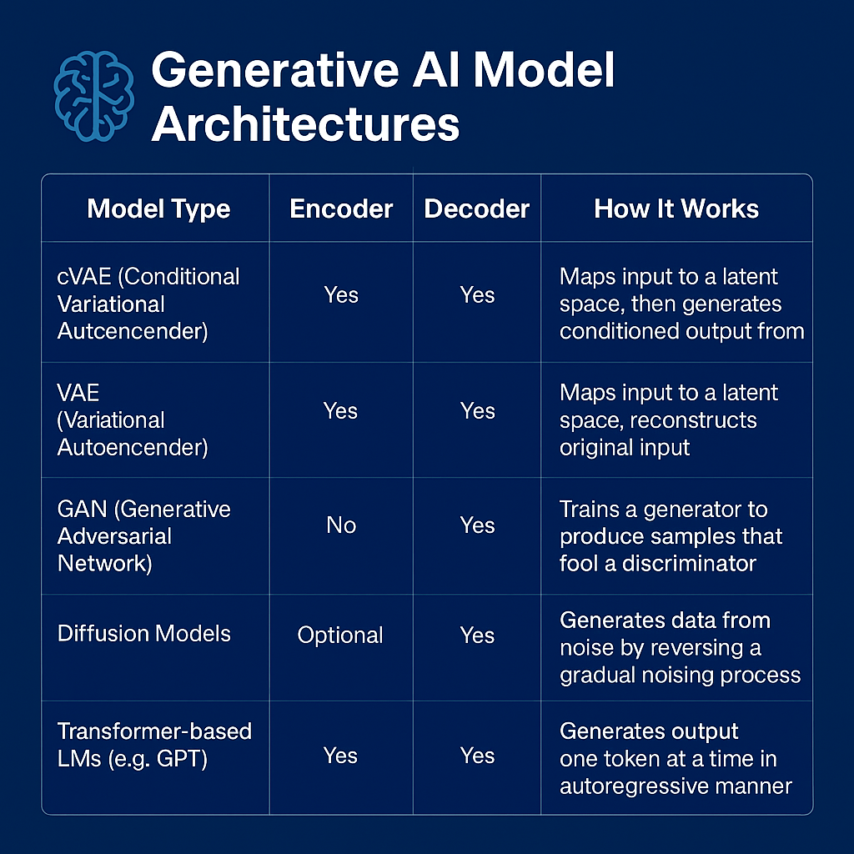

Slide 16
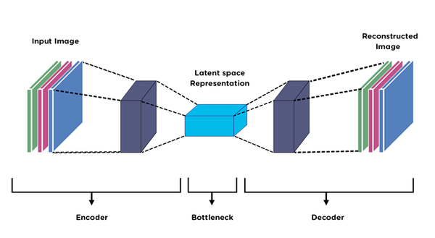
Autoencoders
Source: Premanand S (Analytics Vidhya)

Slide 17
Foundation Models & LLMs
Foundation models are large-scale AI models trained on broad data that can be adapted to a wide range of downstream tasks
Foundation models are used in:
In low-data situations: They can be fine-tuned with small amounts of task-specific data because they already learned general patterns from pretraining.
For versatility across tasks: They are trained on broad data and designed to be adapted to many tasks — even when sufficient data is available.
To reduce training costs: Instead of training a new model from scratch for every task, you start from a foundation model and fine-tune it — saving compute and time.
Large Language Model (LLM) is a deep learning model trained on large text corpora to understand and generate human-like language

Slide 18
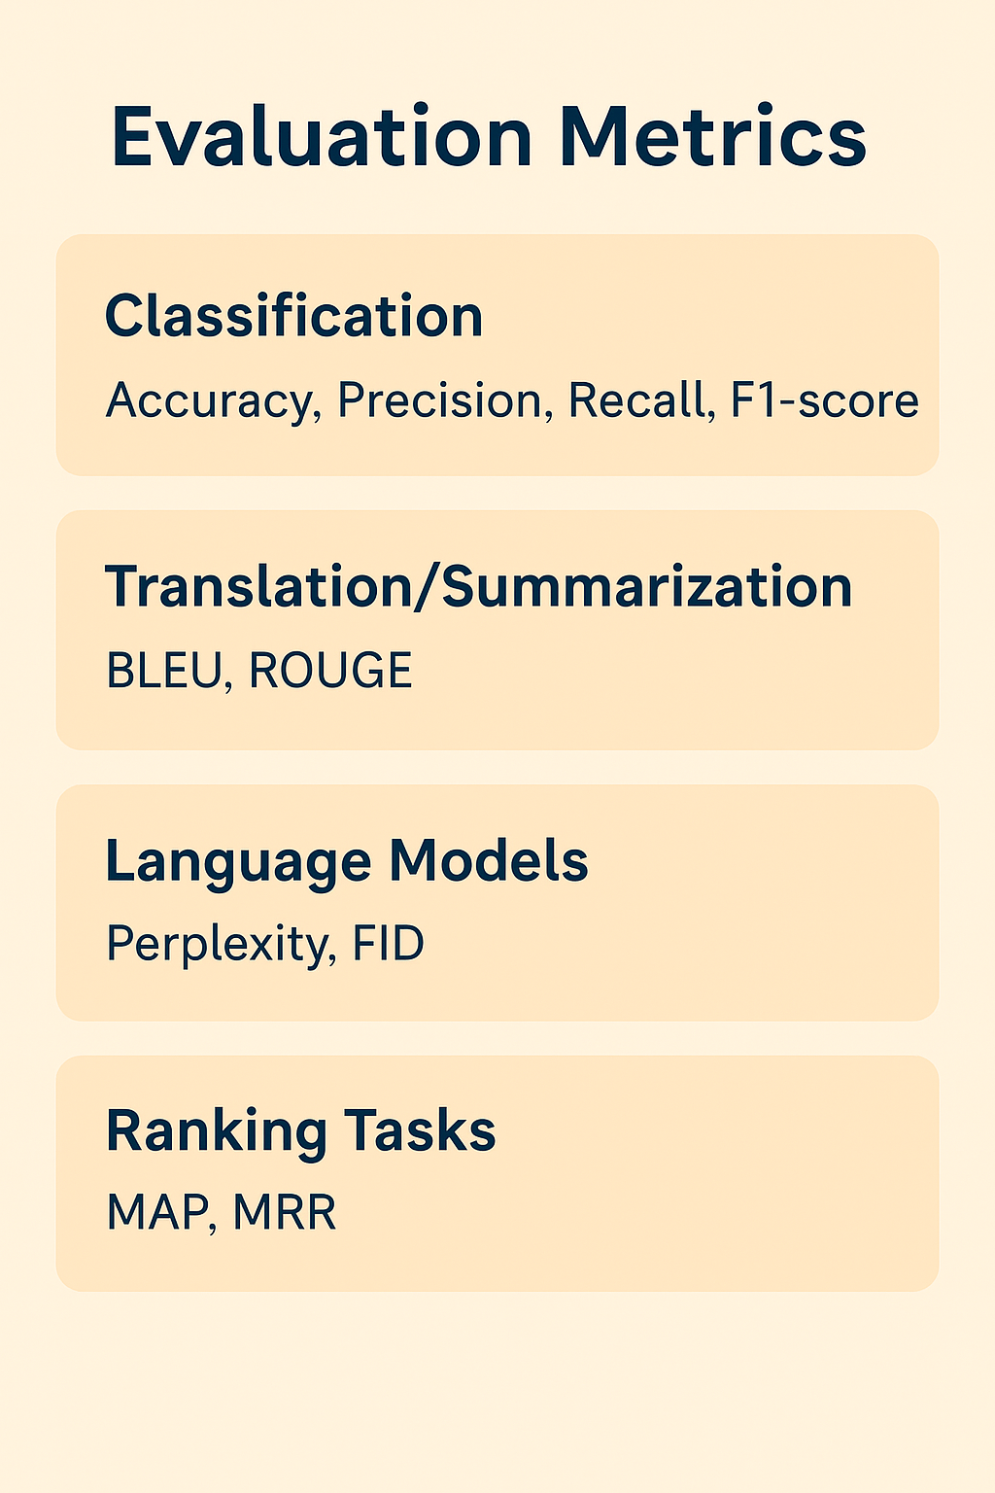
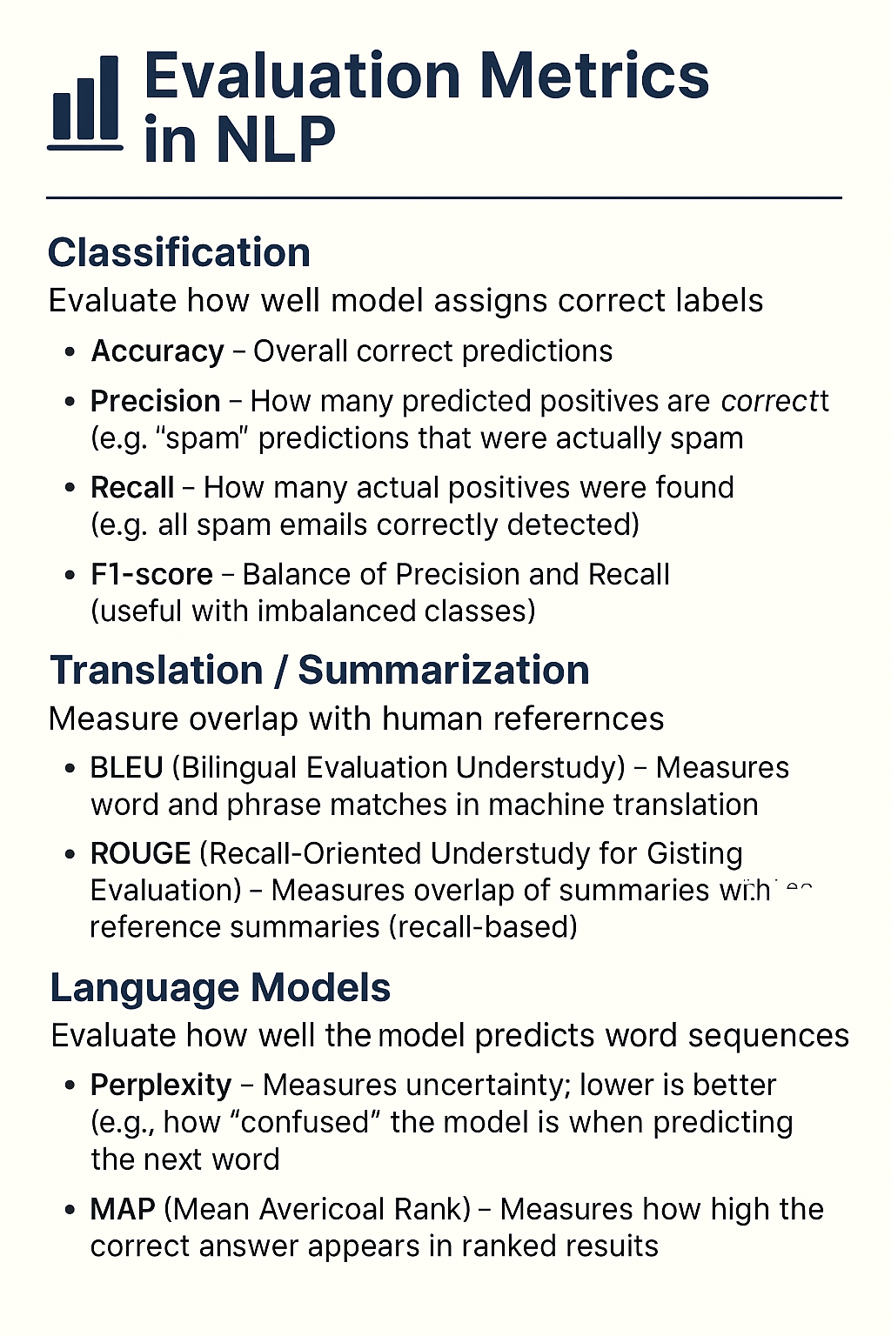

Slide 19
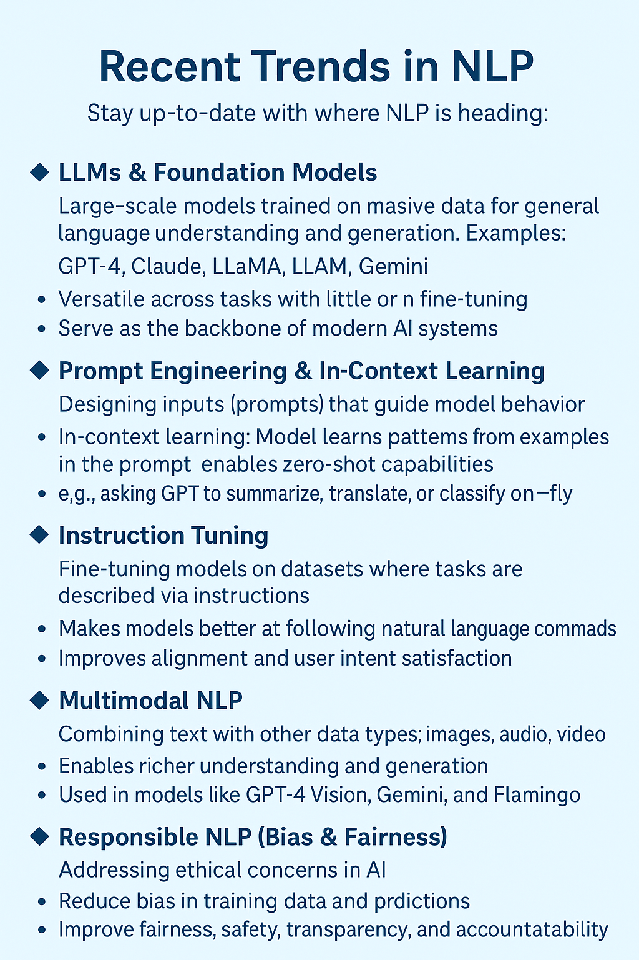
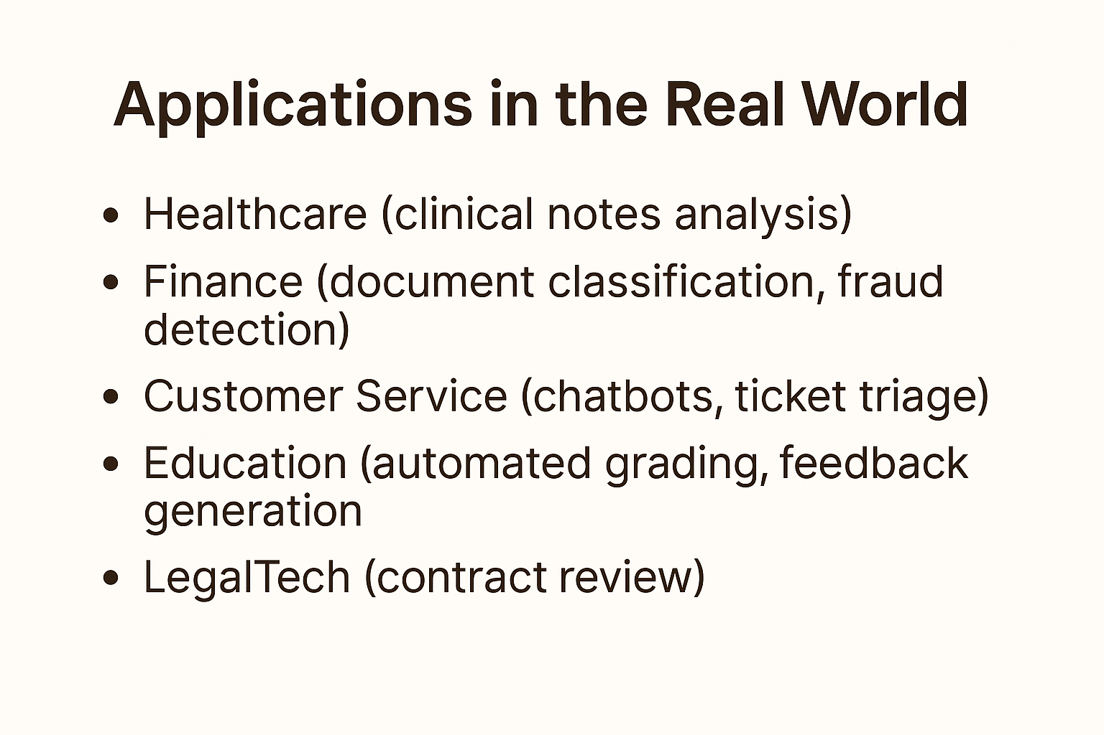

Slide 20
Announcement NELIREF Annual Conference comes up in August 2025, visit our website for more details at https://neliref.org/ Q/A

Slide 21
References
What is AI?. April 24, 2023 | Article by McKinsey. https://www.mckinsey.com/featured-insights/mckinsey-explainers/what-is-ai#/
6 Major Branches of Artificial Intelligence (AI). Neelam Tyagi. Apr 23, 2020, Updated on: Jan 23, 2021. https://www.analyticssteps.com/blogs/6-major-branches-artificial-intelligence-ai
2023 State of AI in 14 Charts. Apr 3, 2023| Shana Lynch. https://hai.stanford.edu/news/2023-state-ai-14-charts
Unleashing the Power of Autoencoders: Applications and Use Cases. Premanand S — Published On May 26, 2023 and Last Modified On June 13th, 2023. https://www.analyticsvidhya.com/blog/2023/05/unleashing-the-power-of-autoencoders-applications-and-use-cases/

Slide 22










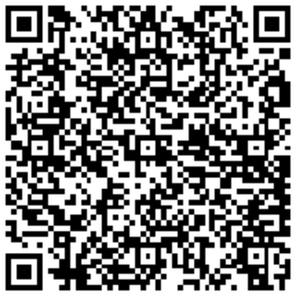



Thank You!
Connect with Us!
We admonish you to live for God and connect with our community!
New Life Research Foundation (NELIREF) Ltd/Gte
Contact @neliref.org newliferesearchfoundation2013@gmail.com
www.neliref.org
+1 (678) 975-5615

Slide 23
Pre-Lab
Core Tools:
Libraries by Topic: Anaconda or Miniconda (for managing environments and packages)
Jupyter Notebook / JupyterLab
Google Colab (optional browser-based platform)
Python (version 3.9 or 3.10)
Statistics for Machine Learning: numpy, scipy, pandas, matplotlib, seaborn, statsmodels
Object-Oriented Programming in Python: No external libraries (uses built-in dataclasses)
Python Programming (Intro & Intermediate): numpy, pandas, matplotlib, plus built-in random, math, itertools
Supervised ML & Deep Learning: scikit-learn, xgboost, lightgbm, tensorflow or pytorch, keras
NLP, LLMs/foundation models, and Generative AI: PyTorch, scikit-learn, transformers (Hugging Face)

Slide 24
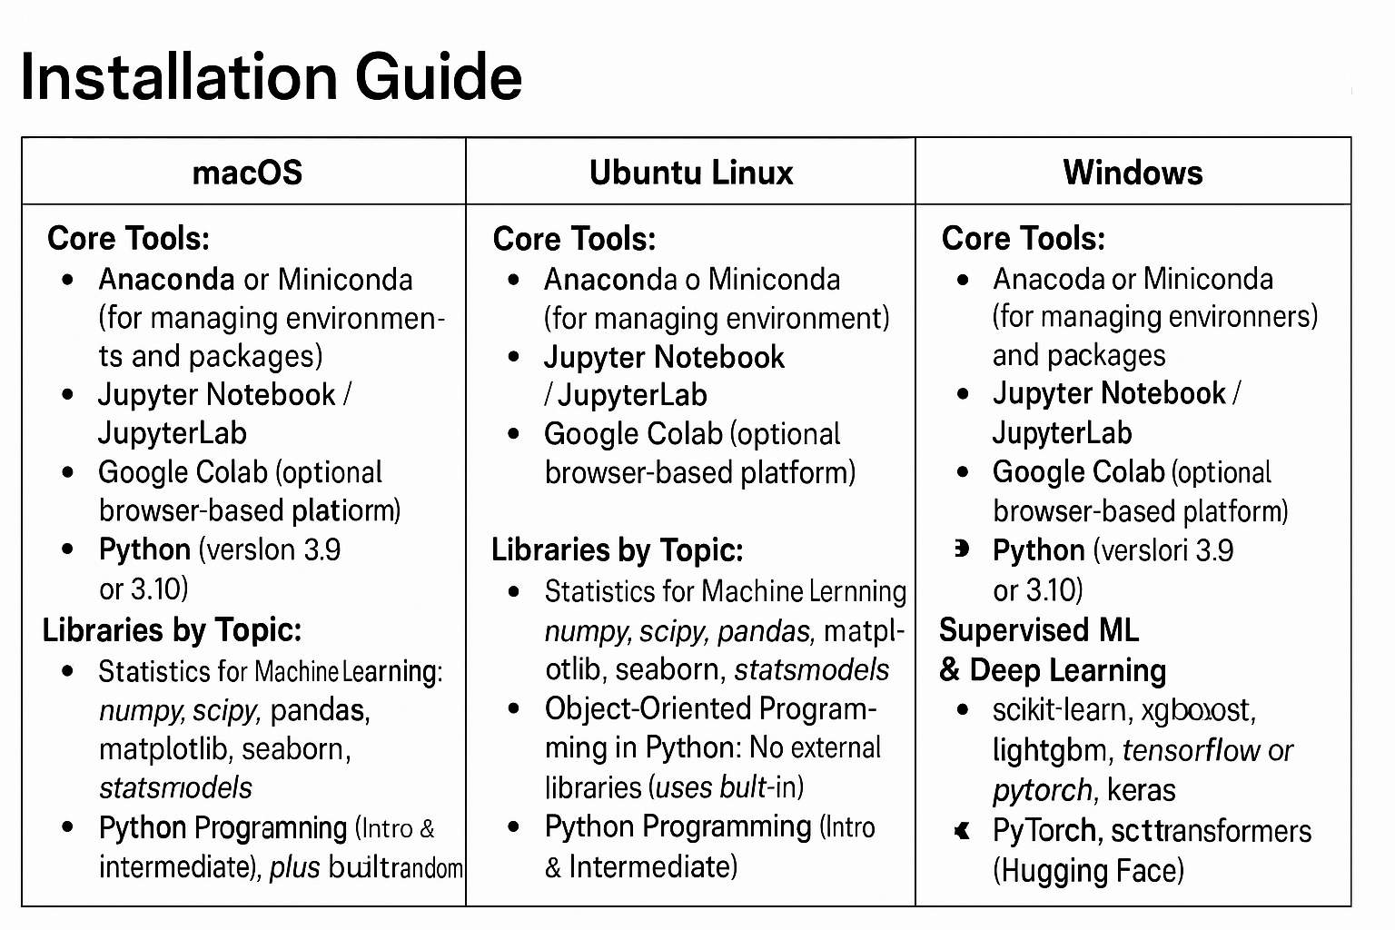
Pre-Lab

Slide 25
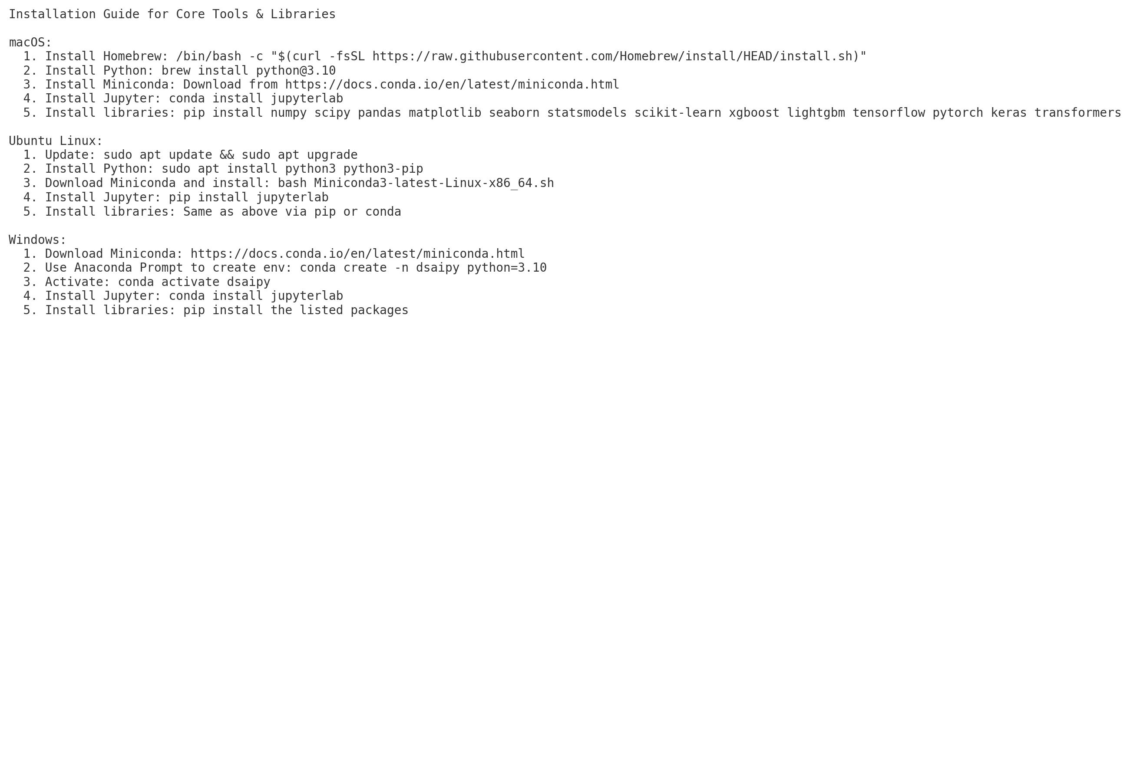
Pre-Lab

